Slide 1
Software Reverse Engineering
Module C1 – File Handling Techniques
Notes:
This slide deck is part of Software Reverse Engineering.
The context of this slide deck in shown below.
Part 0 – SRE in Context
Part A – SRE Prerequisites
Module A1: x86 and x64 Architectures and Assembly Languages
Module A2: ARM Architectures and Assembly Languages
Module A3: Forward Engineering
Part B – Philosophical Approaches to SRE
Module B1: Approaches to SRE
Part C – Static Analysis for Binary SRE
**Module C1: File Handling Techniques
Module C2: Basic Static Analysis Tools
Module C3: Disassemblers and Decompilers
Part D – Dynamic Analysis for Binary SRE
Module D1: Sandboxing and Other Techniques
Module D2: Basic Dynamic Analysis Tools
Module D3: Debuggers
Module D4: Network Traffic Analysis
Module D5: Patched Binaries
Part E – Obfuscation and Anti-SRE
Module E1: Obfuscation and Anti-SRE
Part E – Non-Binary SRE
Module F1: Non-Binary SRE

Slide 2
Table of Contents
Introduction
Acquisition
Transfer
Storage
Examination
Summary
Notes:
These are the topics that are covered in this lesson.

Slide 3
Introduction: Module C1 – Learning Objectives
Upon successful completion of this module, the student should be able to:
Explain various approaches to acquire, transfer, and store malware sample.
Recognize and differentiate between the options available for transfer and storage of malware samples.
Identify and evaluate the techniques for acquiring malware samples.
Notes:
These are the learning objectives for Module C1 – File Handling Techniques
These learning objectives are assessed through the following methods:
ASKs: There are questions in the note sections for the instructor to involve the students in the lesson and assess their grasp of the concepts.
LABs: There are lab exercises associated with this lesson
QUIZ: There are objective quiz questions associated with this lesson.
ESSAY: There are short answer and essay questions associated with this lesson.

Slide 4
Acquisition
(Return to Table of Contents)
Notes:
These are the topics that are covered in this lesson.

Slide 5
Acquisition (cont. 1)
Non-Malicious Software
Malicious Software & Documents
Firmware
Notes:
How do we get things to SRE?
Non–malicious binaries is generally easy to acquire
e.g., Games, applications, server software
Want to bypass game controls, hunt for vulnerabilities, etc.
Get the software the same way you would for an regular install
Malicious software and documents
Includes software and documents you’re not sure about (i.e., *maybe* malicious)
Can find them in the wild (e.g., on an infected host)
Sometimes they exist on the filesystem, but other things only exist in memory (so you need to extract from memory)
Sometimes an infected hosts only has some stages or modules at the point of acquisition
E.g., 1st stage gains foothold, then pulls 2nd (or more) stage to gain persistence and or/preform post compromise activities. So even if you have a compromised host you may not have the 1st stage code
We can set up instrumented hosts or utilities specifically intended to be compromised (i.e. honeypots)
As a result we can potentially capture activity/data/exploits/documents/binaries from throughout the kill chain
More on this approach later in the lab
Acquisition from repositories of unknown/potentially malicious samples
E.g., AV vendor has an endpoint that encounters a binary that triggers heuristics, but doesn’t match against a known threat.
Application whitelisting agent encounters a binary not on the whitelist
Remember that if you’re operating on a compromised host you have to be very careful that
A) The observations you make are valid (i.e., if you ask for a memory dump from a compromised host, it’s in some sense like asking the murdered where to look for the body – there is no reason to believe that they will be truthful.
B) The don’t provide a vector for malicious code to spread (e.g., if you plug in a memory stick, then you risk that memory stick propagating malicious code to your analysis environment).
Firmware
Typically found on a device.
Extraction from the device is usually the first step (from some form of storage ranging from disk/flash to memory to hardware)
Also potentially possible to pull firmware from update servers
Firmware often exists in storage (and updates) as a monolithic blob which is decompressed (and possibly decrypted) into memory at boot. So may need to perform a similar extraction to get something to SRE

Slide 6
Acquisition (cont. 2)
Non-Malicious Software
e.g., Games, applications, server software
Want to bypass game controls, hunt for vulnerabilities, etc.
Get the software the same way you would for an regular install
Notes:
How do we get things to SRE?
Non–malicious binaries is generally easy to acquire
e.g., Games, applications, server software
Want to bypass game controls, hunt for vulnerabilities, etc.
Get the software the same way you would for an regular install
Malicious software and documents
Includes software and documents you’re not sure about (i.e., *maybe* malicious)
Can find them in the wild (e.g., on an infected host)
Sometimes they exist on the filesystem, but other things only exist in memory (so you need to extract from memory)
Sometimes an infected hosts only has some stages or modules at the point of acquisition
E.g., 1st stage gains foothold, then pulls 2nd (or more) stage to gain persistence and or/preform post compromise activities. So even if you have a compromised host you may not have the 1st stage code
We can set up instrumented hosts or utilities specifically intended to be compromised (i.e. honeypots)
As a result we can potentially capture activity/data/exploits/documents/binaries from throughout the kill chain
More on this approach later in the lab
Acquisition from repositories of unknown/potentially malicious samples
E.g., AV vendor has an endpoint that encounters a binary that triggers heuristics, but doesn’t match against a known threat.
Application whitelisting agent encounters a binary not on the whitelist
Remember that if you’re operating on a compromised host you have to be very careful that
A) The observations you make are valid (i.e., if you ask for a memory dump from a compromised host, it’s in some sense like asking the murdered where to look for the body – there is no reason to believe that they will be truthful.
B) The don’t provide a vector for malicious code to spread (e.g., if you plug in a memory stick, then you risk that memory stick propagating malicious code to your analysis environment).
Firmware
Typically found on a device.
Extraction from the device is usually the first step (from some form of storage ranging from disk/flash to memory to hardware)
Also potentially possible to pull firmware from update servers
Firmware often exists in storage (and updates) as a monolithic blob which is decompressed (and possibly decrypted) into memory at boot. So may need to perform a similar extraction to get something to SRE

Slide 7
Acquisition (cont. 3)
Malicious Software & Documents
Includes software and documents you’re not sure about (i.e., *maybe* malicious)
Can find them in the wild (e.g., on an infected host)
Sometimes they exist on the filesystem
Sometimes only in memory
Notes:
How do we get things to SRE?
Non–malicious binaries is generally easy to acquire
e.g., Games, applications, server software
Want to bypass game controls, hunt for vulnerabilities, etc.
Get the software the same way you would for an regular install
Malicious software and documents
Includes software and documents you’re not sure about (i.e., *maybe* malicious)
Can find them in the wild (e.g., on an infected host)
Sometimes they exist on the filesystem, but other things only exist in memory (so you need to extract from memory)
Sometimes an infected hosts only has some stages or modules at the point of acquisition
E.g., 1st stage gains foothold, then pulls 2nd (or more) stage to gain persistence and or/preform post compromise activities. So even if you have a compromised host you may not have the 1st stage code
We can set up instrumented hosts or utilities specifically intended to be compromised (i.e. honeypots)
As a result we can potentially capture activity/data/exploits/documents/binaries from throughout the kill chain
More on this approach later in the lab
Acquisition from repositories of unknown/potentially malicious samples
E.g., AV vendor has an endpoint that encounters a binary that triggers heuristics, but doesn’t match against a known threat.
Application whitelisting agent encounters a binary not on the whitelist
Remember that if you’re operating on a compromised host you have to be very careful that
A) The observations you make are valid (i.e., if you ask for a memory dump from a compromised host, it’s in some sense like asking the murdered where to look for the body – there is no reason to believe that they will be truthful.
B) The don’t provide a vector for malicious code to spread (e.g., if you plug in a memory stick, then you risk that memory stick propagating malicious code to your analysis environment).
Firmware
Typically found on a device.
Extraction from the device is usually the first step (from some form of storage ranging from disk/flash to memory to hardware)
Also potentially possible to pull firmware from update servers
Firmware often exists in storage (and updates) as a monolithic blob which is decompressed (and possibly decrypted) into memory at boot. So may need to perform a similar extraction to get something to SRE

Slide 8
Acquisition (cont. 4)
Malicious Software & Documents
Sometimes an infected hosts only has some stages or modules at the point of acquisition
We can set up instrumented hosts or utilities specifically intended to be compromised (i.e. honeypots)
Acquisition from repositories of unknown/potentially malicious samples
Notes:
How do we get things to SRE?
Non–malicious binaries is generally easy to acquire
e.g., Games, applications, server software
Want to bypass game controls, hunt for vulnerabilities, etc.
Get the software the same way you would for an regular install
Malicious software and documents
Includes software and documents you’re not sure about (i.e., *maybe* malicious)
Can find them in the wild (e.g., on an infected host)
Sometimes they exist on the filesystem, but other things only exist in memory (so you need to extract from memory)
Sometimes an infected hosts only has some stages or modules at the point of acquisition
E.g., 1st stage gains foothold, then pulls 2nd (or more) stage to gain persistence and or/preform post compromise activities. So even if you have a compromised host you may not have the 1st stage code
We can set up instrumented hosts or utilities specifically intended to be compromised (i.e. honeypots)
As a result we can potentially capture activity/data/exploits/documents/binaries from throughout the kill chain
More on this approach later in the lab
Acquisition from repositories of unknown/potentially malicious samples
E.g., AV vendor has an endpoint that encounters a binary that triggers heuristics, but doesn’t match against a known threat.
Application whitelisting agent encounters a binary not on the whitelist
Remember that if you’re operating on a compromised host you have to be very careful that
A) The observations you make are valid (i.e., if you ask for a memory dump from a compromised host, it’s in some sense like asking the murdered where to look for the body – there is no reason to believe that they will be truthful.
B) The don’t provide a vector for malicious code to spread (e.g., if you plug in a memory stick, then you risk that memory stick propagating malicious code to your analysis environment).
Firmware
Typically found on a device.
Extraction from the device is usually the first step (from some form of storage ranging from disk/flash to memory to hardware)
Also potentially possible to pull firmware from update servers
Firmware often exists in storage (and updates) as a monolithic blob which is decompressed (and possibly decrypted) into memory at boot. So may need to perform a similar extraction to get something to SRE

Slide 9
Acquisition (cont. 5)
Malicious Software & Documents
If you are operating on a compromised host you have to be very careful that
A) The observations you make are valid
B) They don’t provide a vector for malicious code to spread.
Notes:
How do we get things to SRE?
Non–malicious binaries is generally easy to acquire
e.g., Games, applications, server software
Want to bypass game controls, hunt for vulnerabilities, etc.
Get the software the same way you would for an regular install
Malicious software and documents
Includes software and documents you’re not sure about (i.e., *maybe* malicious)
Can find them in the wild (e.g., on an infected host)
Sometimes they exist on the filesystem, but other things only exist in memory (so you need to extract from memory)
Sometimes an infected hosts only has some stages or modules at the point of acquisition
E.g., 1st stage gains foothold, then pulls 2nd (or more) stage to gain persistence and or/preform post compromise activities. So even if you have a compromised host you may not have the 1st stage code
We can set up instrumented hosts or utilities specifically intended to be compromised (i.e. honeypots)
As a result we can potentially capture activity/data/exploits/documents/binaries from throughout the kill chain
More on this approach later in the lab
Acquisition from repositories of unknown/potentially malicious samples
E.g., AV vendor has an endpoint that encounters a binary that triggers heuristics, but doesn’t match against a known threat.
Application whitelisting agent encounters a binary not on the whitelist
Remember that if you’re operating on a compromised host you have to be very careful that
A) The observations you make are valid (i.e., if you ask for a memory dump from a compromised host, it’s in some sense like asking the murdered where to look for the body – there is no reason to believe that they will be truthful.
B) The don’t provide a vector for malicious code to spread (e.g., if you plug in a memory stick, then you risk that memory stick propagating malicious code to your analysis environment).
Firmware
Typically found on a device.
Extraction from the device is usually the first step (from some form of storage ranging from disk/flash to memory to hardware)
Also potentially possible to pull firmware from update servers
Firmware often exists in storage (and updates) as a monolithic blob which is decompressed (and possibly decrypted) into memory at boot. So may need to perform a similar extraction to get something to SRE

Slide 10
Acquisition (cont. 6)
Non-Malicious Software
Malicious Software & Documents
Firmware
Notes:
How do we get things to SRE?
Non–malicious binaries is generally easy to acquire
e.g., Games, applications, server software
Want to bypass game controls, hunt for vulnerabilities, etc.
Get the software the same way you would for an regular install
Malicious software and documents
Includes software and documents you’re not sure about (i.e., *maybe* malicious)
Can find them in the wild (e.g., on an infected host)
Sometimes they exist on the filesystem, but other things only exist in memory (so you need to extract from memory)
Sometimes an infected hosts only has some stages or modules at the point of acquisition
E.g., 1st stage gains foothold, then pulls 2nd (or more) stage to gain persistence and or/preform post compromise activities. So even if you have a compromised host you may not have the 1st stage code
We can set up instrumented hosts or utilities specifically intended to be compromised (i.e. honeypots)
As a result we can potentially capture activity/data/exploits/documents/binaries from throughout the kill chain
More on this approach later in the lab
Acquisition from repositories of unknown/potentially malicious samples
E.g., AV vendor has an endpoint that encounters a binary that triggers heuristics, but doesn’t match against a known threat.
Application whitelisting agent encounters a binary not on the whitelist
Remember that if you’re operating on a compromised host you have to be very careful that
A) The observations you make are valid (i.e., if you ask for a memory dump from a compromised host, it’s in some sense like asking the murdered where to look for the body – there is no reason to believe that they will be truthful.
B) The don’t provide a vector for malicious code to spread (e.g., if you plug in a memory stick, then you risk that memory stick propagating malicious code to your analysis environment).
Firmware
Typically found on a device.
Extraction from the device is usually the first step (from some form of storage ranging from disk/flash to memory to hardware)
Also potentially possible to pull firmware from update servers
Firmware often exists in storage (and updates) as a monolithic blob which is decompressed (and possibly decrypted) into memory at boot. So may need to perform a similar extraction to get something to SRE

Slide 11
Transfer
(Return to Table of Contents)
Notes:
These are the topics that are covered in this lesson.

Slide 12
Transfer (cont.)
Do you need to transfer it?
What should you transfer?
How do you transfer it?
Notes:
So you have found something interesting to examine, how can you get it to somewhere you can start to do the SRE?
So maybe you don’t move it at all
Examine it in place, or from hypervisor, or from network
May allow us to gain better insight (or at least initial understanding), particularly if dynamic analysis is going to be important and replicating it elsewhere will be hard
Network traffic, in-memory-only constructs, targeted malware, 2nd+ stages only (so we can’t ”reinstall” easily)
Non-malicious software is a good candidate (but some of this, e.g., games, still checks for SRE efforts)
If you’re moving it
How much of the environment can you, and do you want to, transfer?
Possible to take full capture of host (e.g., as a disk image, or as a VM). If the host is already a VM or a container this can be pretty easy)
Binaries and documents from filesystem
Memory captures
Network captures
Some description of the system to include OS/software versions (particularly if you want to perform dynamic SRE, so that you can replicate the environment)
How to move it
Over the network (AV does this all the time)
On removable media
As a VM/container
Careful to prevent cross contamination (e.g., with removable media)
Think about intermediate systems that may open/scan/etc. the sample (e.g., file share service that creates thumbnails or performs AV scans, or network services that perform similar actions). Operating system file managers like to create thumbnails and grab file types and characteristics, browsers like to render some file types in the browser (or use plugins to render them), AV engines like to parse and examine any file that they see, mail clients like to provide file info (and even inline rendering), etc.
Can zip samples for transmission (but remember that zip/tar/gzip/etc. is a utility that takes as it’s input the possibly malicious files you’re compressing, and that software + adversary provided input can have interesting outcomes, as is unzip/untar/gunzip/etc.). Password is ”infected” ☺, which makes it less likely that 3 years from now you’ll run across some previously zipped malicious sample and run it by mistake.

Slide 13
Storage
(Return to Table of Contents)
Notes:
These are the topics that are covered in this lesson.

Slide 14
Storage (cont.)
Where to store?
How to store?
Notes:
Easy to think of storage as a container, but it’s not quite correct
AV systems scan storage looking for malware (and again, AV is program that accepts as input the files on your storage devices, which in your case may have been provided by an adversary. Also AV is generally highly privileged, meaning that if things go wrong they can go very wrong)
OS creates thumbnails, parses for quick search, etc.
Lots of network connected and/or shared storage (e.g., backup systems, Dropbox, iCloud, etc.) so things that are “on our hard drive” are often elsewhere too
So we want to store things on devices that reduces the potential for unwanted interaction
Also worth requiring some level of effort to access to reduce mistakes (“hey, I wonder what’s in this document”)
Password to unlock (zipped, encrypted, etc.) can prevent inadvertent access

Slide 15
Examination
(Return to Table of Contents)
Notes:
These are the topics that are covered in this lesson.

Slide 16
Examination (cont.)
You should be prepared to lose any host you’re using for SRE
…and all of the data on it
Extend that to anything those hosts connect to
Notes:
Ability to discard and redeploy and analysis host is important
Certainly for malware analysis
Also for analysis of non-malicious samples (good to be able to reset to known state and start over)
VMs are a good way to achieve this, but in some cases physical hosts are required
Depending on the level of the sample/adversary, you may want to assume that the virtualization platform, the physical host, and any network equipment should also be expendable
Static analysis can be relatively easy to perform in isolated environments.
Dynamic analysis is harder to perform in isolated environments

Slide 17
Summary
We have looked at the main concepts associated with the four stages of file handling that are typically performed as part of an SRE effort.
Acquire
Transfer
Store
Examine
SRE of malware is DANGEROUS.
Notes:
This section provides a summary of the key points of the lesson and the expected capabilities that students should master before moving on to the next section.

Slide 18
Honeypot Lab
(Return to Table of Contents)

Slide 19
Honeypots and Honeynets 1
“An information system resource whose value lies in unauthorized or illicit use of that resource.”
Lance Spitzner, Honeynet Project Founder
Notes:
Introduction to the concept
Used from research to major production environments

Slide 20
Honeypots and Honeynets 2
“An information system resource whose value lies in unauthorized or illicit use of that resource.”
Lance Spitzner, Honeynet Project Founder
“To learn the tools, tactics and motives involved in computer and network attacks, and share the lessons learned.”
Honeynet Project Mission Statement
http://honeynet.org
Notes:
Introduction to the concept
Used from research to major production environments

Slide 21
Demonstrations
Honssh Honeypot - Skilled Attacker
Kippo SSH Honeypot - Attacker #1
Kippo SSH HoneyPot - Attacker #2
An Intruder Enjoying Kippo Honeypot

Slide 22
Warning
WARNING!
We are about to interact with live attackers and live malware. This is dangerous!
Notes:
You cannot overemphasize the seriousness of this issue.

Slide 23
SSH into your Honeypot
Using PuTTY or other ssh client
User: ubuntu
Password: <FILL IN PASSWORD HERE>
Use port 60022

Slide 24
Start The Honeypots
There are two Honeypots
Cowrie and Dionaea
Start both from the command line:
./startCowrie.sh
./startDionaea.sh

Slide 25
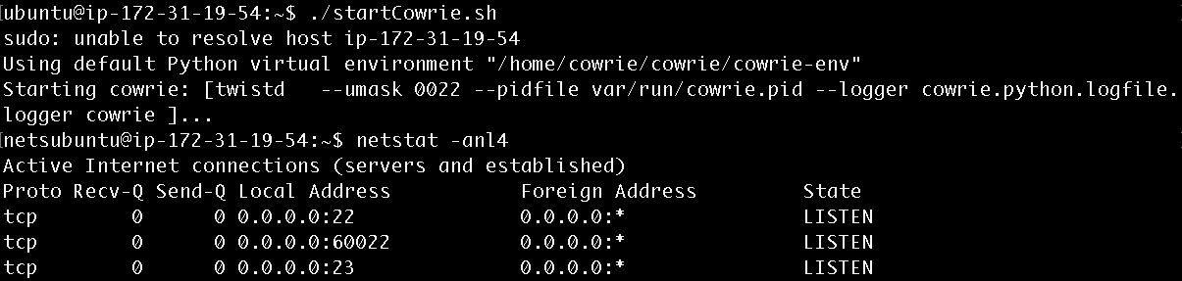
Start The Honeypots (cont.)
/startCowrie.sh
netstat –anl4

Slide 26
SSH to Honeypot 1
Open a new PuTTY/SSH Client Window
SSH into the honeypot:
Default port (22)
User: root
Password: <any password is fine>
ssh root@<YOUR IP>
Notes:
Probably worth switching to new virtual desktop

Slide 27
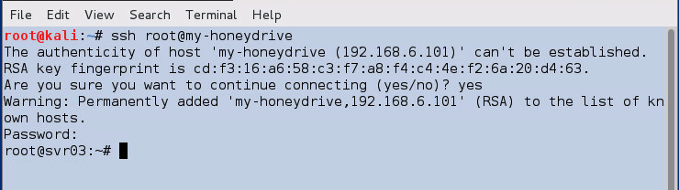
SSH to Honeypot 2
Notes:
Demonstration of connecting to the honeypot on the real SSH service

Slide 28
SSH to Honeypot 3
Run some standard commands
ls
hostname
cat /etc/passwd
ifconfig
…

Slide 29
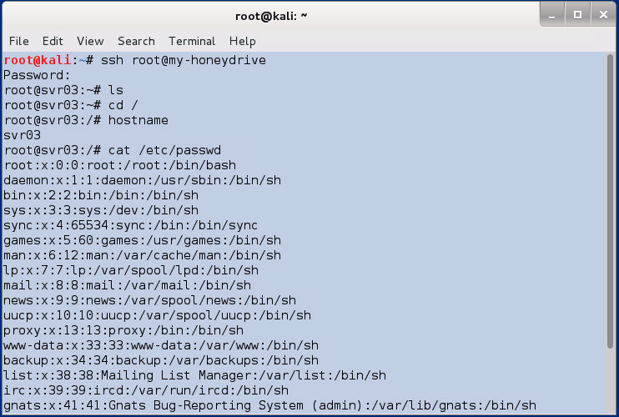
SSH to Honeypot 4
Notes:
Example of running some commands in the honeypot

Slide 30
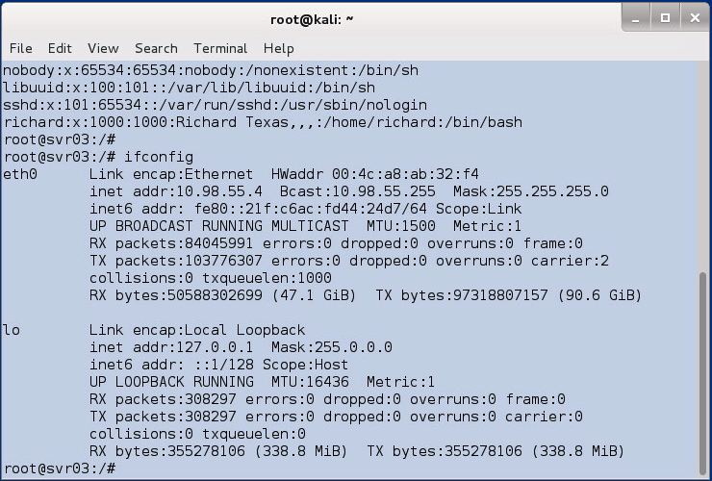
SSH to Honeypot 5
Notes:
Example of running some commands in the honeypot

Slide 31
SSH to Honeypot 6
Exit the SSH session

Slide 32
Downloaded Files
Downloaded files are dangerous!
Notes:
Downloaded files are dangerous!

Slide 33
Look at Downloaded File
sudo su - cowrie
Downloaded files are stored in /home/cowrie/cowrie/dl
You should assume that these files are real malware, that could compromise
your honeypot host,
your network,
other hosts inside and outside your environment

Slide 34
Interesting Locations/Files
Base is /home/cowrie/cowrie/
README.md
cowrie.cfg
dl/*
data/fs.pickle
data/userdb.txt
log/*
log/tty/*
Notes:
All from /home/cowrie/cowrie

Slide 35
dionaea
Traps malware exploiting vulnerabilities exposed by network services.
Objectives – Obtain a copy of the malware

Slide 36
Services
SMB
MS SQL Server
MySQL
HTTP/HTTPS
FTP/TFTP
SIP
Others…
pcap option for other ports
Notes:
Q) Do students know what these services are?

Slide 37
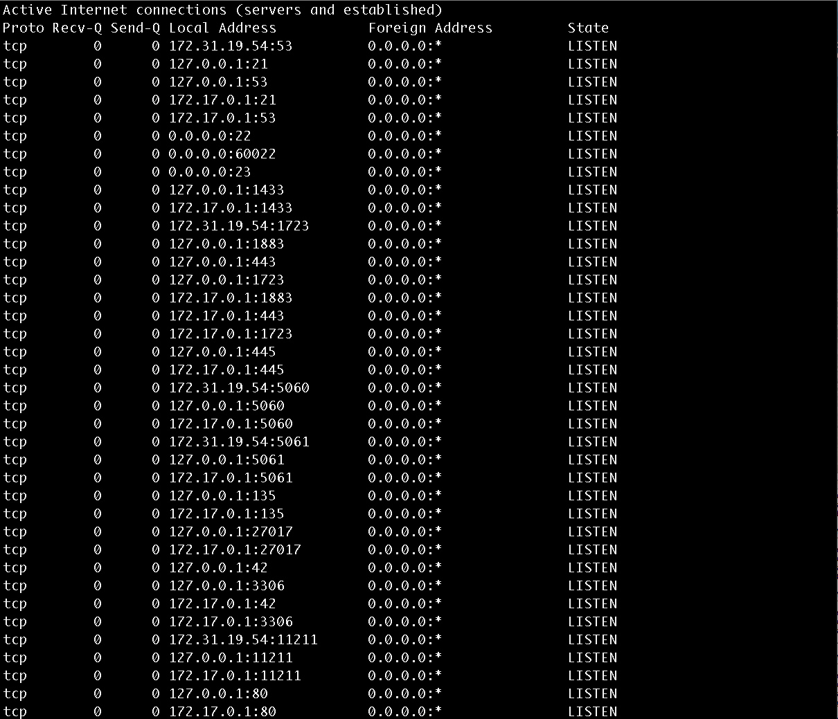
Services 1
/startDionaea.sh
netstat –anl4
Notes:
There are now lots of open ports on the honeypot

Slide 38
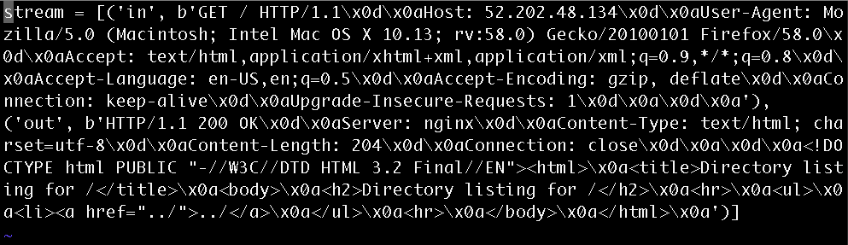
Services 2
/opt/dionaea/var/dionaea/bistreams/*
Notes:
Example of a bistream as a result of an interaction between an “attacker” and the Dionaea honeypot

Slide 39
Interesting Locations/Files 2
var/dionaea/binaries
var/dionaea/bistreams
var/dionaea/dionaea.log
var/dionaea/roots/*
var/dionaea/*.sqlite
etc/dionaea/dionaea.cfg
etc/dionaea/service-enabled/*
Notes:
All from /opt/dionaea

Slide 40
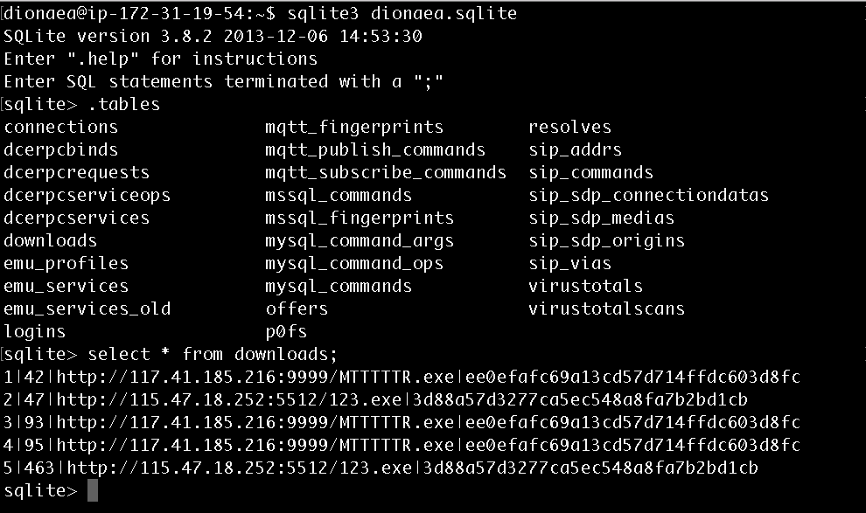
Interesting Locations/Files 1
sqlite3 dionaea.sqlite
.tables
select * from downloads;
Notes:
We can interact directly with the Dionaea sqlite databate

Slide 41
Virus Total 1
You can get some basic analysis of files and URLs using Virus Total
https://virustotal.com
If you see URLs in your honeypot logs, or binary files that were downloaded, you can upload them to Virus Total
If in doubt about how to do this, please ask me

Slide 42
Virus Total 2
3 tabs on interface
File Upload
URL
Search
Use this to search for the hash of downloaded binaries. Get the hash on your EC2 instance using
md5 <binary>

Slide 43
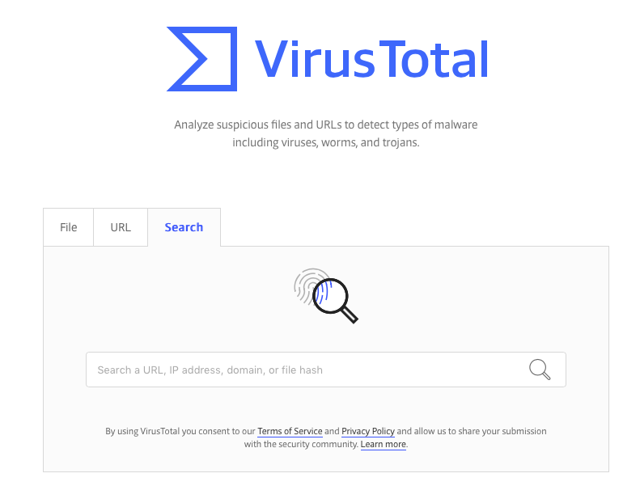
Virus Total 3

Slide 44
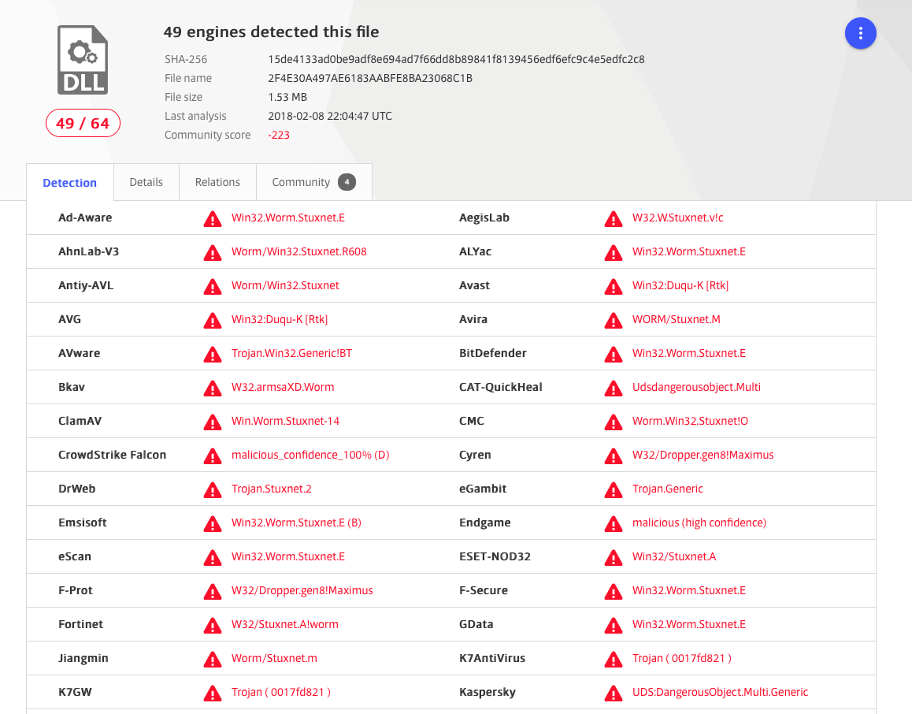
Virus Total 4

Slide 45
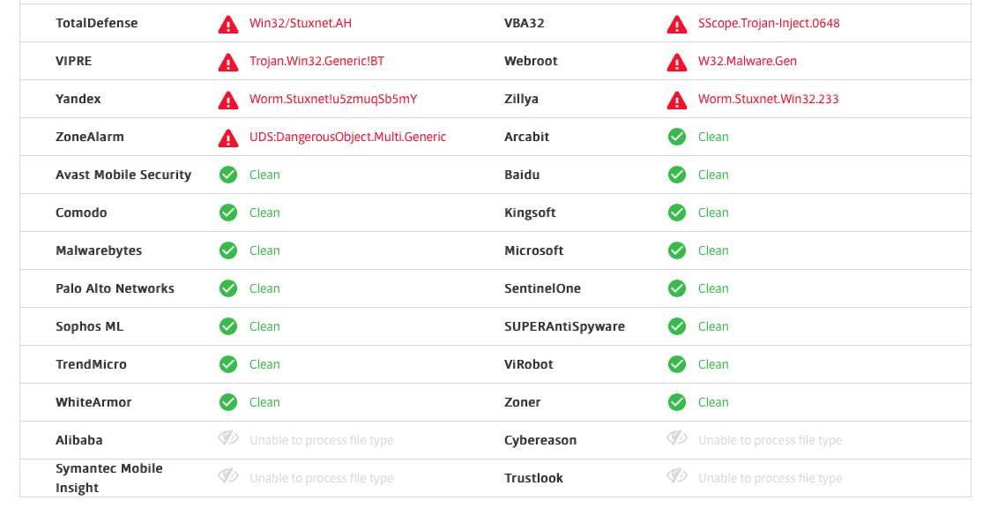
Virus Total 5

Slide 46
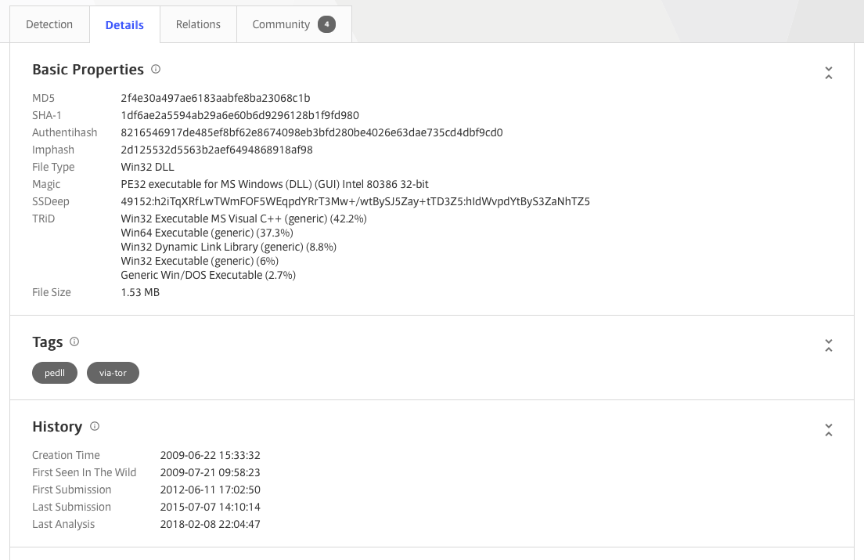
Virus Total 6

Slide 47
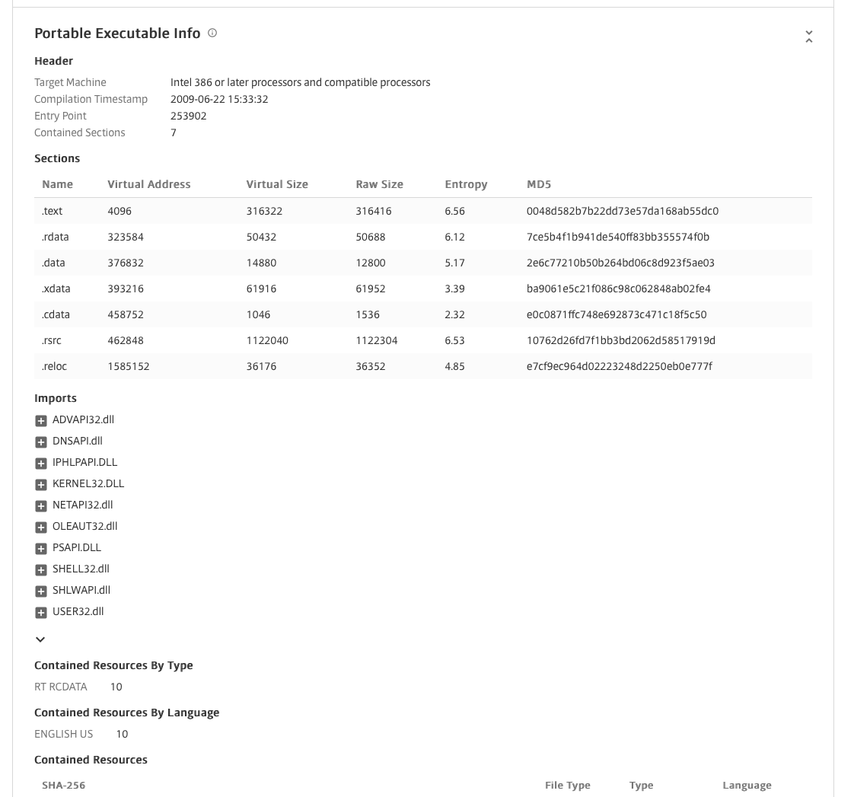
Virus Total 7

